Slide 1
RECOGNITION AND CLASSIFICATION OF DIGITS AND LETTERS
Harsh Parikh
Sanket Nitin Wagh

Slide 2
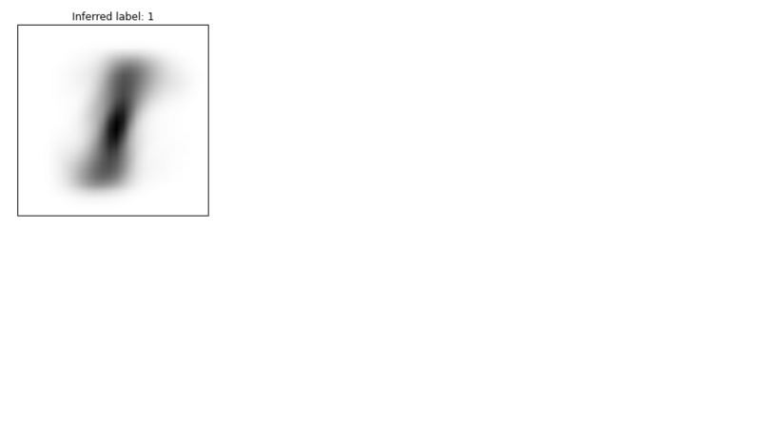
PROBLEM STATEMENT
The Problem:
It has become important to extract and recognize the data effectively.
To successfully recognize the data is not an easy task.
The Objective:
Our primary objective is to perform recognition of the data.
Train the data and test on hand written digits and letters.
We will use various algorithms to classify the data.

Slide 3
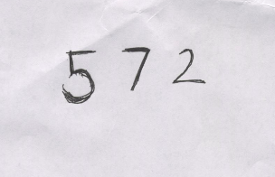
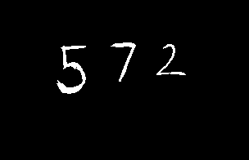
FEATURE EXTRACTION
OpenCV library used.
Once the characters are recognized:
Application of gray scale.
Application of Gaussian Blur
Application of Threshold.

Slide 4
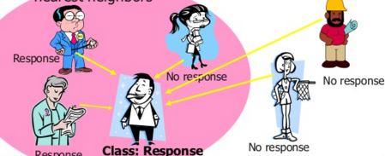
K-NEAREST NEIGHBORS
Instance based lazy algorithm
Euclidean distance is used in the first step.
Distance between given data points is obtained.
‘K’ most similar instances selected.
‘Response’ provided by selected neighbors.
This is the prediction of class.

Slide 5
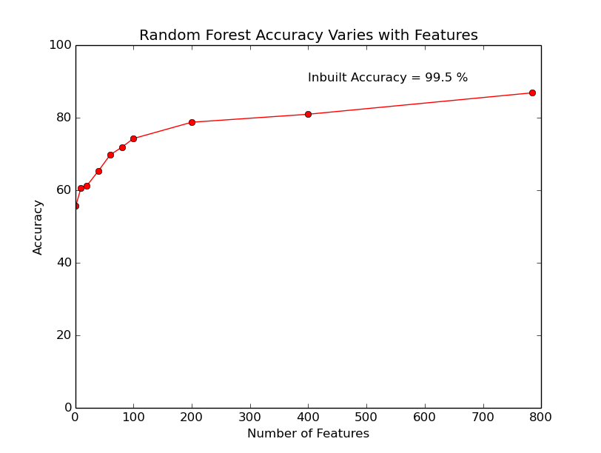
PRINCIPAL COMPONENT ANALYSIS
PCA is used to identify patterns.
Projects data onto a smaller subspace.
Reduces the number of features of the data.
We use this aspect and determine accuracy values for various dimensions of data.

Slide 6
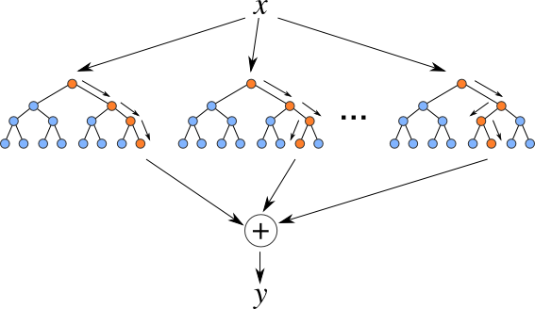
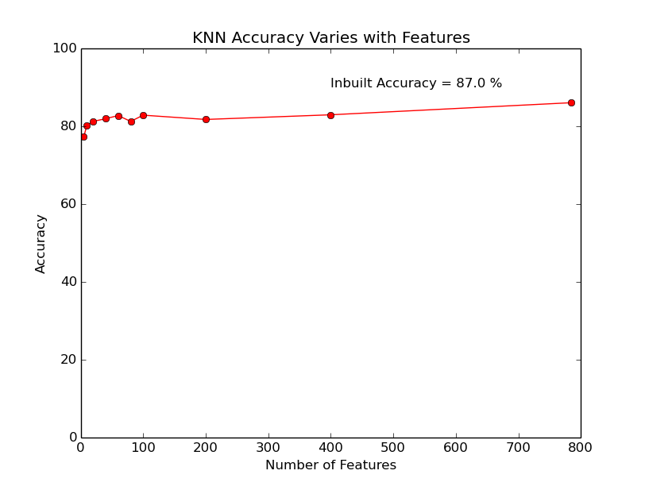
RANDOM FORESTS
We will focus on classification using random forests.
Data divided into sample subsets.
Each subset of data generates a decision tree.
Each tree classifies the data and produces a result. The aggregate result is utilized.
This provides a more efficient result.

Slide 7
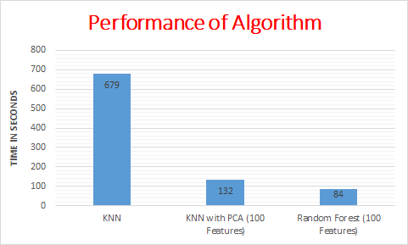
RESULTS AND CONCLUSIONS
Performance with respect to accuracies and time:

Slide 8
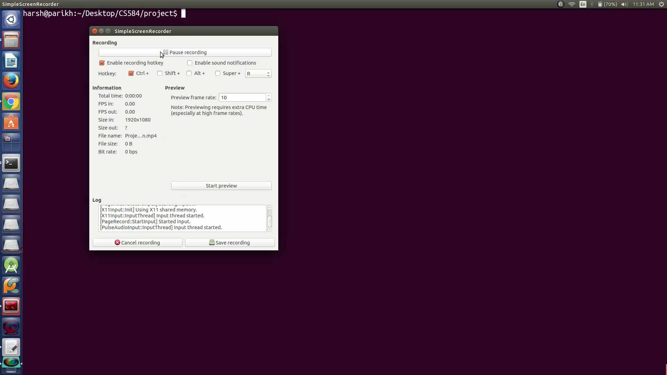
TEST RESULTS DISPLAY

Slide 9
Thank you….. Q & A ??

